Slide 1

PRIVACY NOT GUARANTEED
Privacy in Deep Learning
Notes:
Image from https://ruble1.wordpress.com/2014/02/26/the-language-of-the-future/

Slide 2

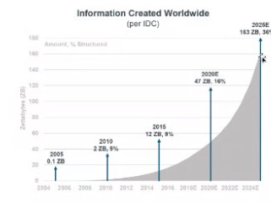
RISK TO PRIVACY
Data Availability
Exponential growth
Crowd sourced
Direct Exposure
Data breaches
Indirect Exposure
Inference based
Notes:
https://www.kdnuggets.com/2018/12/predictions-industry-2019.html
https://devops.com/crowdsourced-software-testing/

Slide 3


DIRECT EXPOSURE
Compromised on Infrastructure
Unsecured communication channels
Insider attacks
Notes:
https://securionpay.com/blog/ssl-certificates/
2018 that they found four
million Android apps that were sending unencrypted user profile data to advertisers’ servers
employees are responsible for 43% of data leakage,

Slide 4
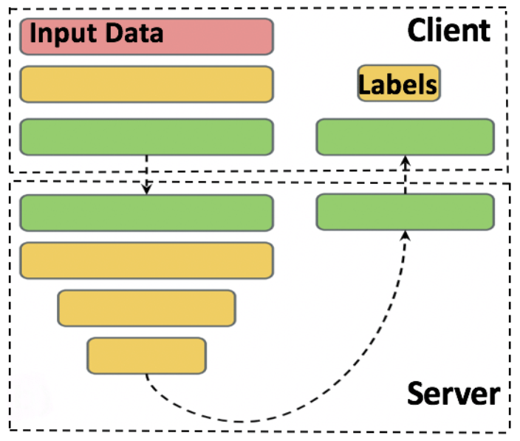
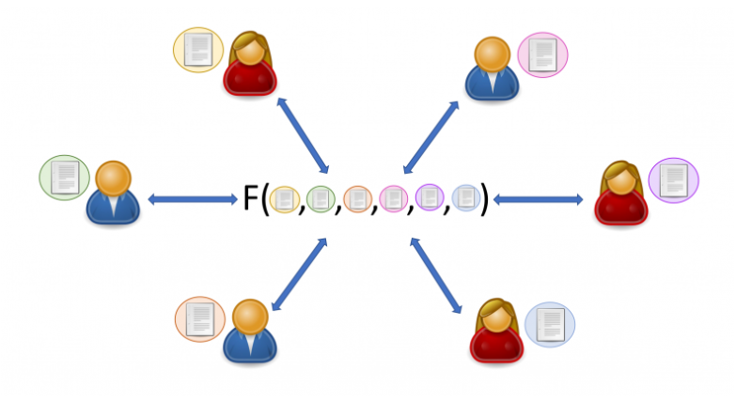
DIRECT EXPOSURE MITIGATION
Training
Federated learning or split learning
Inference
Homomorphic encryption, secure multi-party computation, trusted execution environments
Notes:
https://www.insperity.com/blog/hr-data-privacy/
https://www.thesslstore.com/blog/what-is-homomorphic-encryption/
https://www.researchgate.net/figure/Split-learning-configurations-for-health-shows-raw-data-is-not-transferred-between-the_fig2_329387825
In a nutshell, homomorphic encryption is a method of encryption that allows any data to remain encrypted while it’s being processed and manipulated.

Slide 5
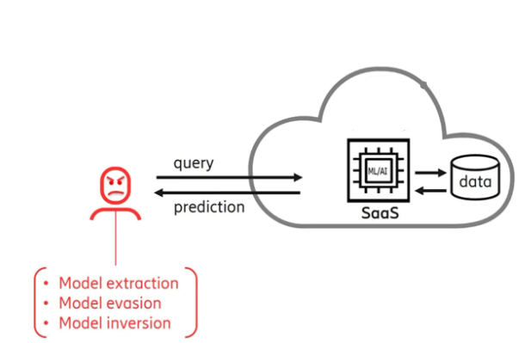
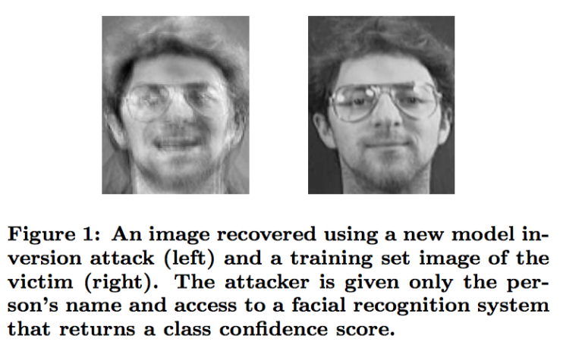
INDIRECT EXPOSURE
Inferring from prediction
Membership inference
Attributes (model inversion)
Parameters (model stealing)
Notes:
https://www.ericsson.com/en/blog/2020/10/ai-security-mobile-networks

Slide 6
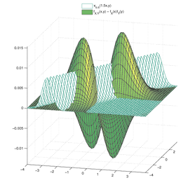
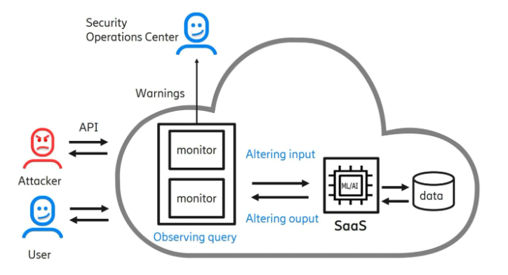
INDIRECT EXPOSURE MITIGATION
Aggregating and anonymizing
Context free and context aware
Differential privacy
Adding noise
Notes:
Naïve anonymization
K-anonymity
Context aware – information theoretic privacy – based on information theory, it explicitly models the dataset statistics – generative adversarial privacy to generate private datasets

Slide 7
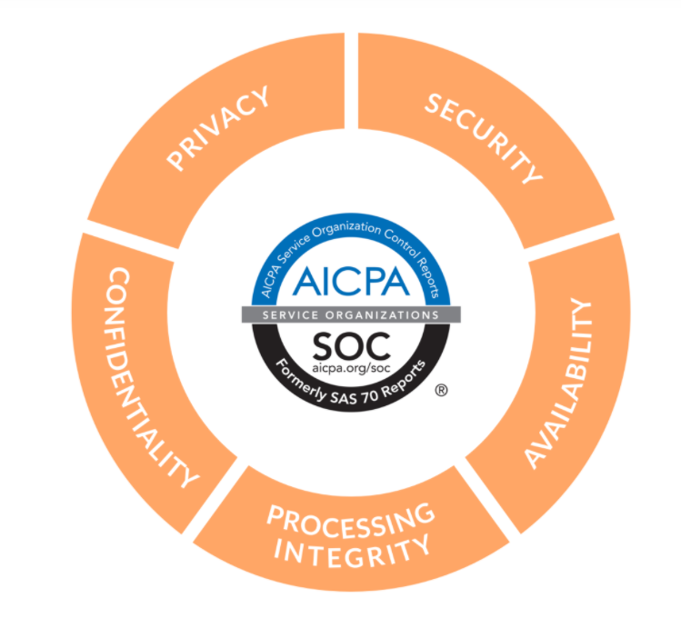
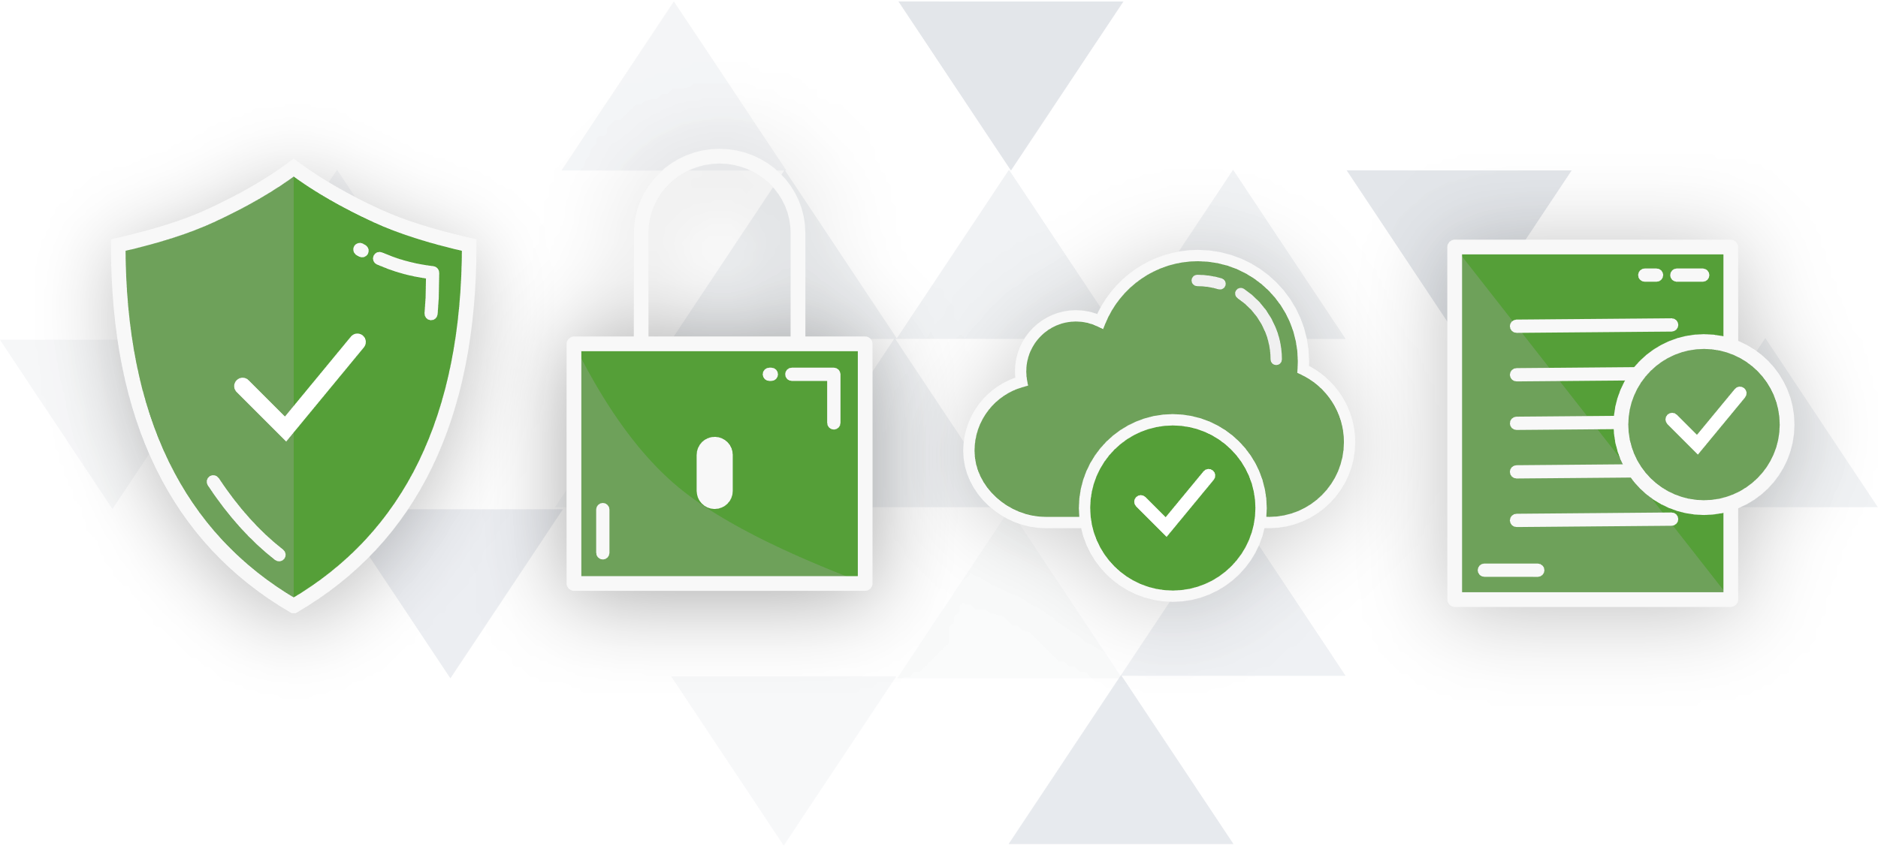
CONCLUSION
Direct exposure
Not unique to ML
SOC 2 Compliance
Indirect exposure
New techniques
ML privacy compliance
Notes:
https://www.onetrust.com/trust/
SOC 2 compliance like for service providers
Indirect exposure, new attacks are being discovered

